Slide 1
Aligning Agile EA With Business Strategy

Slide 2
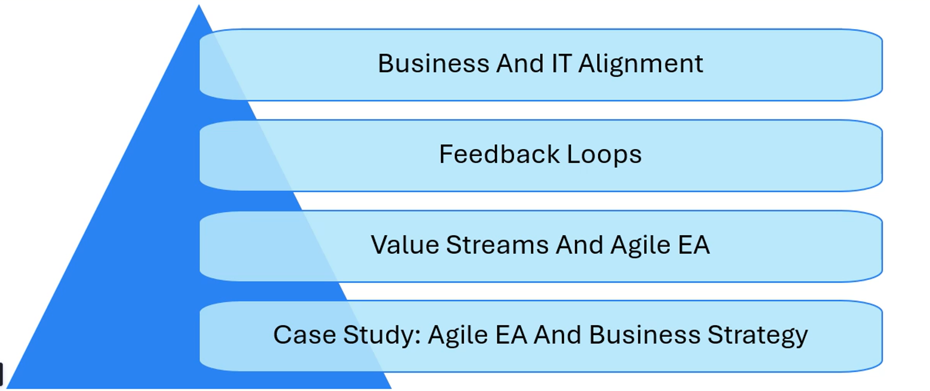
Aligning Agile EA With Business Strategy

Slide 3
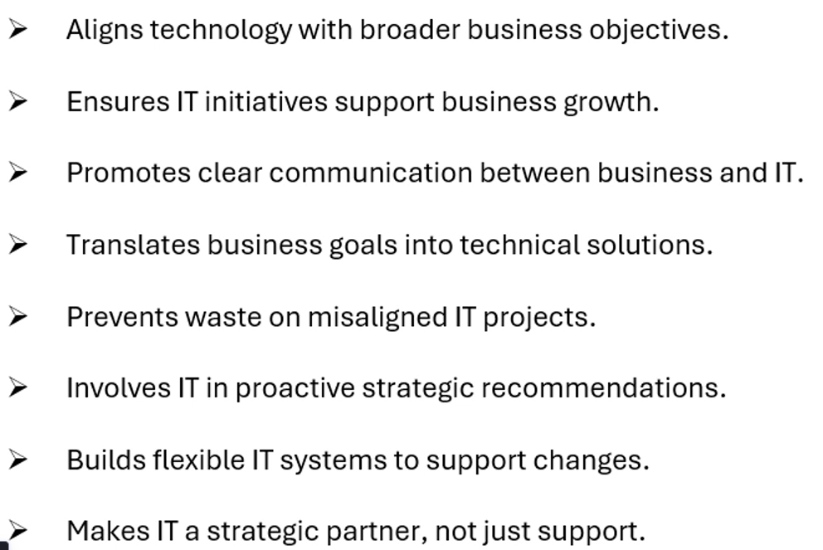
Business And IT Alignment

Slide 4
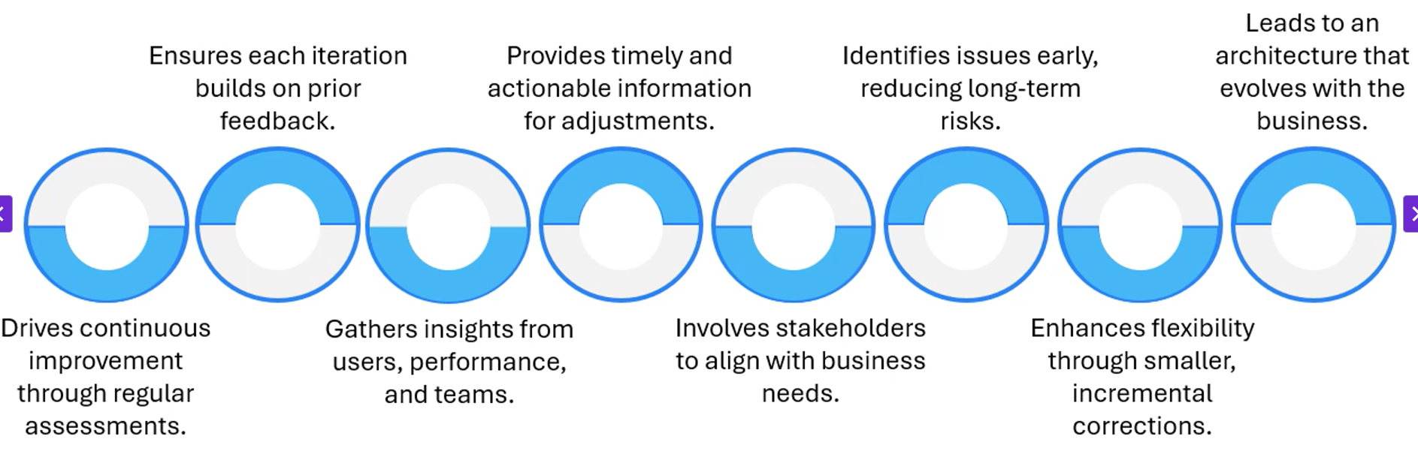
FeedBack Loops

Slide 5
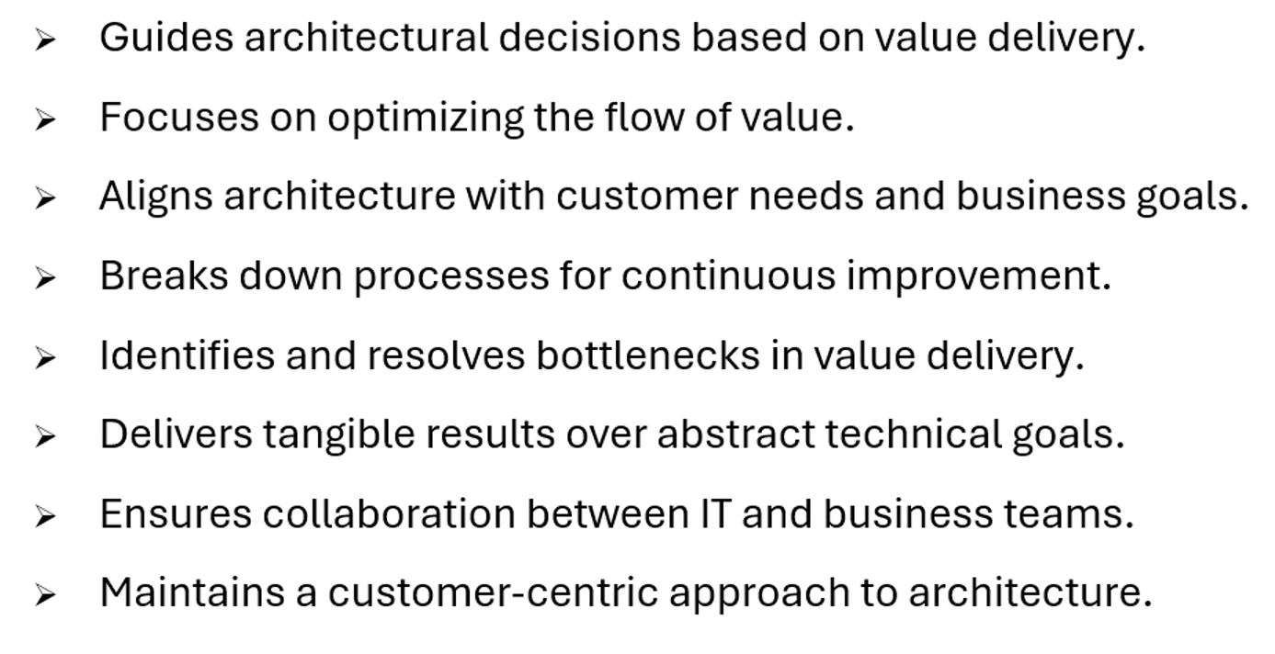
Value Streams And Agile EA

Slide 6
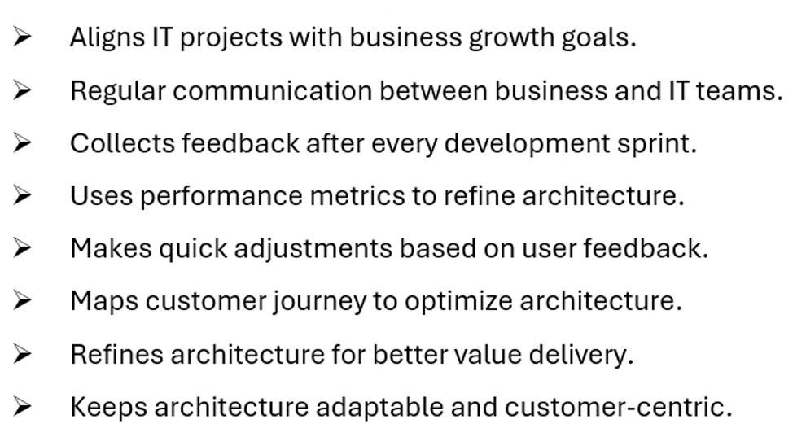

The TechWave Case

